Slide 1



2024/5 GEM Report on leadership and education
Lead for technology
Regional edition on East Asia
Manos Antoninis
Director, Global Education Monitoring Report
Global Smart Education Conference
Beijing, 18 August 2025

Slide 2
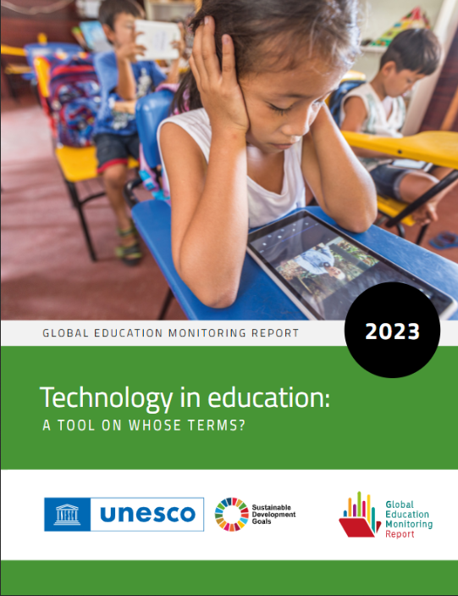
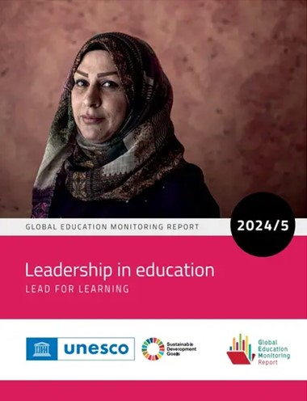
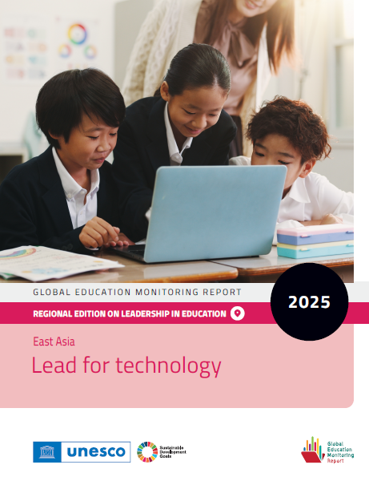
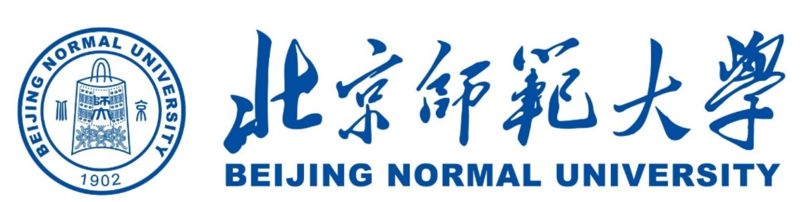


Regional edition on East Asia
Links the 2024/5 GEM Report on leadership
with the 2023 GEM Report on technology
Three country case studies:
◆ China: Ronghuai Huang, Jianhua Zhao, Jingwen Pan, Mohamed Oubibi and TingWen Chang (Beijing Normal University)
◆ Japan: Jun Kawaguchi and Yuta Yoneda
◆ Republic of Korea: Eun Young Kim (Korean Educational Development Institute)
One framework paper from Prof. Junjun Chen

Slide 3
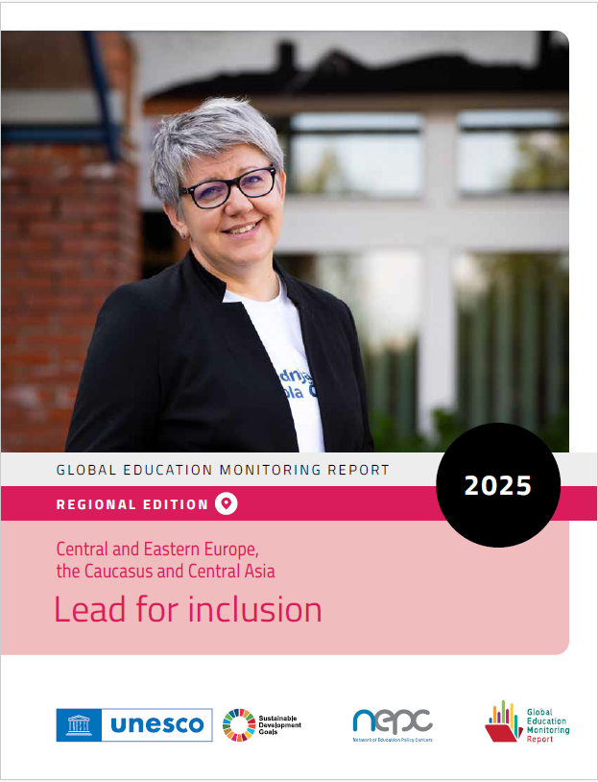





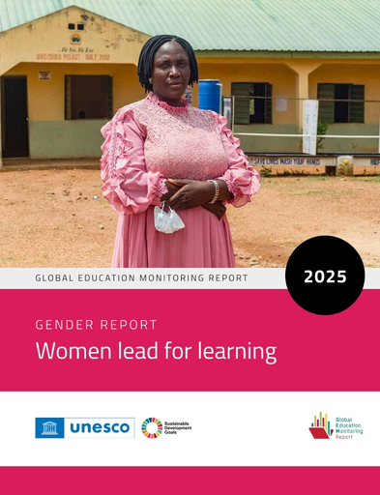
Regional and thematic editions on leadership
Central and Eastern Europe, Caucasus and Central Asia Lead for inclusion
Focus: Albania, Bosnia/Herzegovina, Estonia, Georgia, Kyrgyzstan, Poland, Republic of Moldova and Slovenia
East Asia Lead for technology
Focus: China, Japan, Rep. of Korea
FEB
2025
AUG
2025
Latin America Lead for democracy
Focus: Argentina, Brazil, Chile, Colombia, Costa Rica, Honduras
APR
2025
Africa Instructional leadership
Focus: Cameroon, Côte d'Ivoire, Kenya, Morocco, Zimbabwe
OCT
2025
MAY
2025
A gender report on women in educational leadership positions
A report on youth participation in education policy development
JAN
2026

Slide 4

East Asia is a champion of digital transformation in education
In China, the Digital China initiative and the 2018 Education Informatization Plan 2.0
>50% of schools have independent digital management platforms
AI education in all schools by 2030
In Japan, Society 5.0 and GIGA Programme
One-device-per student target under GIGA brought forward from 2023 to 2020
In Korea, Digital New Deal and aster Plan VII
AI-powered textbooks fully rolled out by 2028

Slide 5



School and system leaders matter for digital transformation
As the organization of teaching and learning shifts, leaders at local government and school level are critical for reform implementation
School leaders’ roles and responsibilities are more complex:
◆ Facilitate a digital culture, organize staff capacity development and select resources based on school needs
◆ From procurement to cybersecurity; from pedagogy to well-being
These are now being recognized in new digital strategies:
In China, school principals designated as Chief Information Officers
In Japan, the 2023 education digital transformation strategy positions principals as key drivers of digital innovation

Slide 6
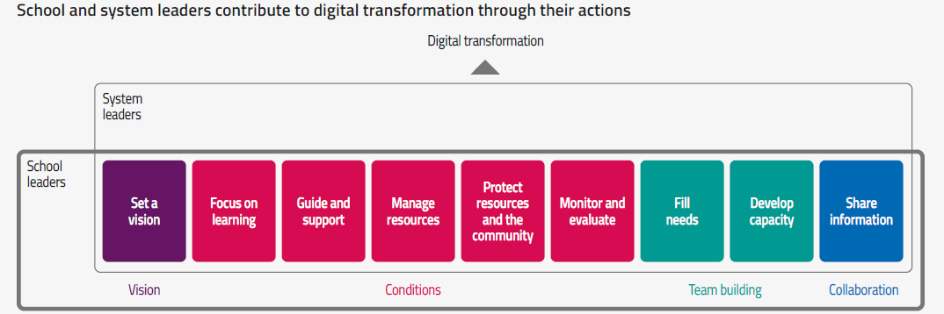
School and system leaders matter for digital transformation

Slide 7
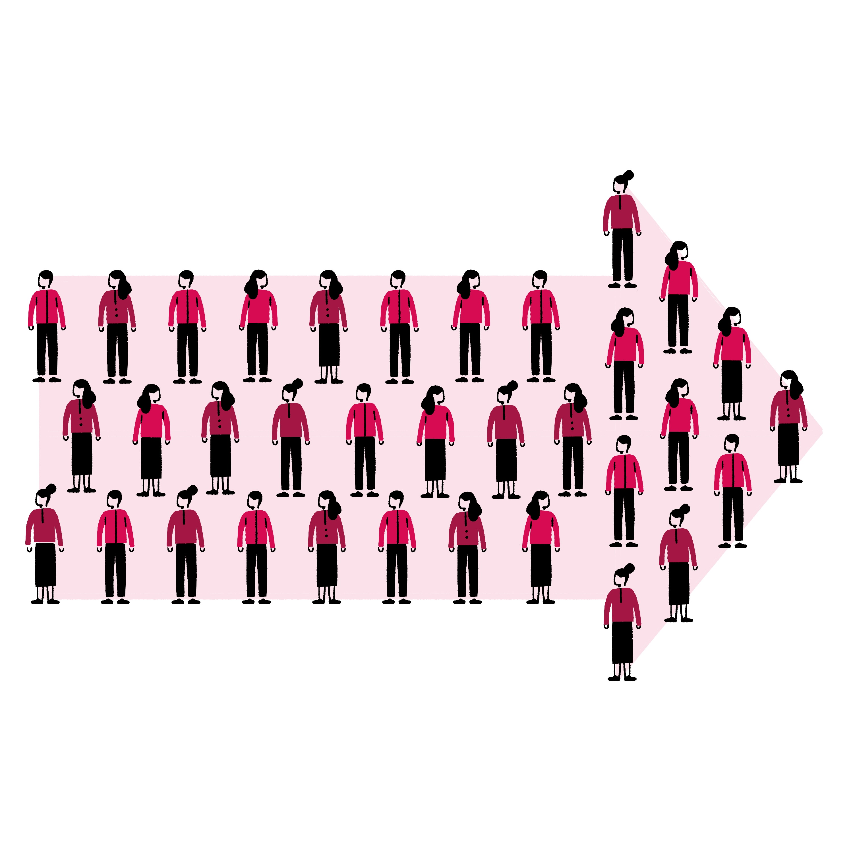
1. Clear and coherent policy framework
Leaders should have a clear understanding of technology reforms and their objectives
Interoperable systems are needed for coherence  Japan developed Education Data Standard 4.0 in 2023 to facilitate seamless data transfer
◆ China integrated 32 provincial platforms into a unique national Smart Education Platform
Tradeoffs between promise and disadvantage
Target schools with good initial conditions for experiments with technology or focus on inequality?
e.g. in China, some programmes favour rural, remote and minority areas but demonstration zones tend to be in affluent areas
Recommendations

Slide 8

2. Clear guidance and standards
Provide well-defined responsibilities and autonomy with sufficient support
In China, the central government establishes technical standards to ensure compatibility of digital education systems across provinces
In Japan, the Guidelines for Use of Generative AI in Primary and Secondary Education (2024) define appropriate use and highlight risks for personal information, privacy and copyright
In Korea, the General Guidelines of the 2022 Revised National Curriculum outline how to implement AI-powered digital textbooks
+ Digital Education Code of Conduct

Slide 9

3. Engagement in technology decisions
Solicit and reflect their views to ensure pedagogically appropriate reforms
Tradition of centralized, hierarchical planning:
in Korea, the National Assembly reclassified Ai textbooks from core to supplementary materials
Voluntary adoption could lead to universal adoption if central governments set standards and incentives
e.g. computer-based testing system in Japan
Both Japan and Korea consulted teachers when developing their digital strategies
e.g. an EdTech Information platform in Korea formally engages teachers

Slide 10

4. Collaboration within/between schools
…and between schools and parents
Digital transformation is not just technology adoption  Communities of practice and professional networks
A survey of principals in China found that the preferred training format was peer exchange
Qinghai Province built partnerships with its digitally advanced peers in Shanghai, Jiangsu and Zhejiang
In Japan, departments at prefecture Boards of Education link municipalities on data security, networking and digital education regulations
In Korea, AI Education Alliance and Policy Lab (AIEDAP) promotes collaboration between leaders to build trust and mutual support networks

Slide 11

5. New selection and training processes
Evolution is needed to match demands
In Japan, local authorities include proficiency in digital skills for principal recruitment
Japan and Korea use talent-based recruitment too
China, Japan and Korea:
◆ require new principals to receive training
◆ updated competency frameworks to include AI
Hubei Province digital literacy program extends to bureau directors, principals and ICT coordinators
In Japan, prefecture boards of education provide role-based training programmes on ICT integration
In Korea, since 2023, secondary school principals take a Digital-Based Educational Innovation course

Slide 12

6. Specialized staff
Relieve leaders of technical responsibilities
In China, schools appoint specialized ICT coordinators to lead adoption and training for digital tools
In Japan, MEXT has appointed School DX Strategy Advisors to support Boards of Education and schools;
Mobile instructional support staff provide TA and training; their shortage negatively impacts learning;
GIGA School Supporters design and set up ICT environments and create ICT usage guidelines
In Korea, digital tutors will be hired to manage the set-up and maintenance of digital equipment
Teacher champions in China, GIGA leaders in Japan and lead teachers in Korea support peers as coaches

Slide 13
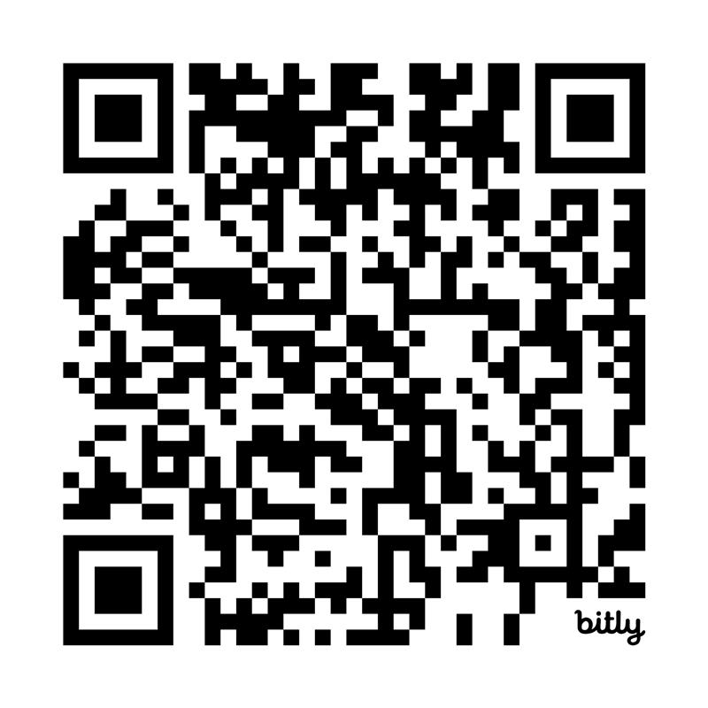


Thank you!

